Slide 1
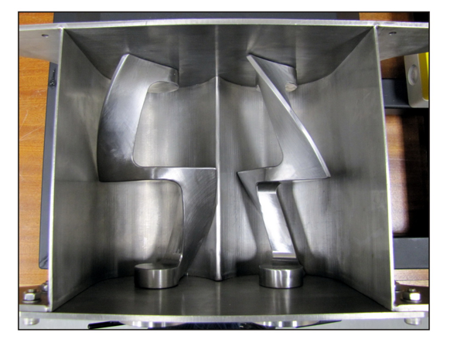
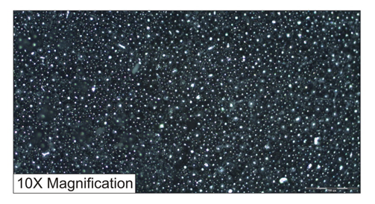
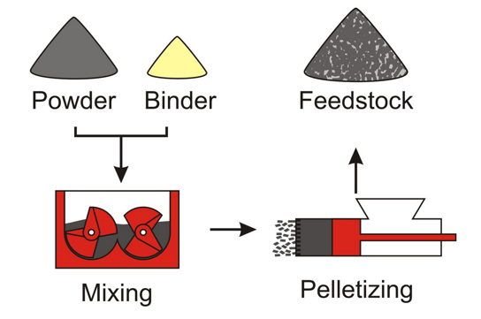
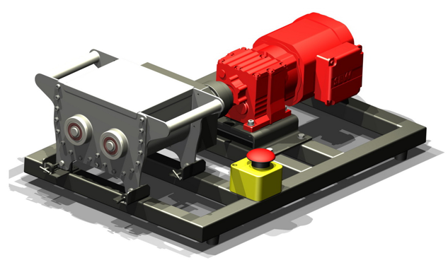
Powder Injection Moulding of Ti-6AI-4V Titanium Alloy: Feedstock and Mixer
Author: JE Hoffman Supervisor: Prof DC Blaine Department of Mechanical and Mechatronic Engineering January 2024
Introduction
Powder injection moulding (PIM) is a proven method to fabricate small parts of complex geometries. Further development of PIM technologies for use with titanium requires the creation of a suitable feedstock.
Objectives
The aim of this study is to create a feedstock for titanium that is suitable for PIM. To facilitate feedstock creation, a suitable mixer must be created.
Method
Mixing chamber of the designed sigmablade mixer
Mixer assembly
Mixer Assembly
Results
The homogeneously mixed thermoplastic feedstock consists of gas atomised Ti-6AI-4V powder with a binder layer consisting of mixed paraffin wax, polyethylene, polypropylene and stearic acid.
Conclusions
The designed sigma blade mixer and above combination of materials proved successful in creating a homogeneous feedstock.
Acknowledgements
Jaco Smith (Sasol), David Altland (Polyvisions), Keven Neaves and MMW staff

